Slide 1

Knowledge Graph: Introduction

Slide 2
Knowledge Graph: Roadmap
1736. Graph theory was born: Leonhard Euler formulated the Königsberg Bridge Problem.
1960-1970. Formalization of Semantic Network and first applications.
1976. John F. Sowa published his first paper on Conceptual Graphs.
1982. Knowledge Graphs were invented in the Netherlands. The theory of Knowledge Graphs was initiated by C. Hoede, a mathematician at the University of Twente, and F.N. Stokman, a mathematical sociologist at the University of Groningen.
1999. Resource Description Framework (RDF) Model was published as a W3C Recommendation to lay a foundation for a Semantic Web.

Slide 3
Knowledge Graph: Roadmap
2001. Tim Berners-Lee, Jim Hendler and Ora Lassila published their ground-breaking article "The Semantic Web" in the Scientific American Magazine.
2006. the DBpedia project created a seed for the emergence of the Linked Open Data cloud by transforming Wikipedia content into linked data.
2010. The Labelled Property Graph model was developed.
2012. Google introduced their Knowledge Graph, and since then a lot of companies have started to build their own projects using knowledge graphs in various flavours.
2018. The GraphQL* Manifesto was published to agree on a standard for a property graph query language (ISO/IEC 39075).
2019. Knowledge graphs had become mainstream, involving several disciplines.
*not to be confused with GraphQL for querying APIs.

Slide 4
Data Models

Slide 5
Knowledge Graph: Definitions
Euler circles and Venn diagrams helped humans to reason through visual insights.
Semantic networks and Conceptual Graphs:
  knowledge representation through diagrams (specifically graphs) and visual means;
  computational procedures and algorithms to perform formal reasoning;
  combinations of formal (logical) and statistical forms of reasoning;
  relevance of different types of data (e.g., images, sound) as sources of knowledge.
Knowledge graph is a graph where nodes represent entities, and edges represent relationships between those entities. Usually, it is a directed edge labelled (property) graph (2014)
A knowledge graph is a graph-structured knowledge base (KB) (2016) -- KB is any logical formalism that can assert what is true in the considered domain.

Slide 6
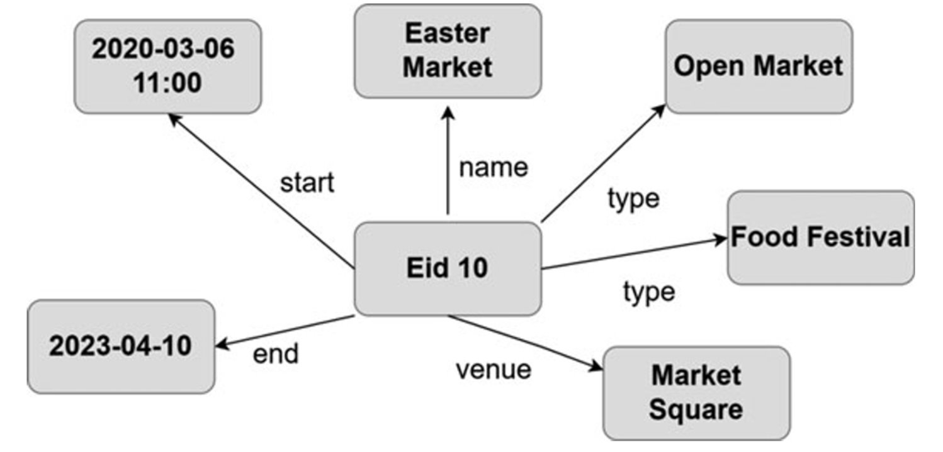
Knowledge Graph: Definitions

Slide 7
Knowledge Graph: Definitions
A knowledge graph is a structure amounting to a set of objects in which some pairs of the objects are in some sense related (Ehrlinger and Wöß, 2016).
A knowledge graph is a structure intended to accumulate and convey knowledge of the real world, whose nodes represent entities of interest and whose edges represent relations between these entities.
A knowledge graph mainly describes real world entities and their interrelations, organized in a graph; defines possible classes and relations of entities in a schema; allows for potentially interrelating arbitrary entities with each other; covers various topical domains.
A knowledge graph describes objects of interest and connections between them. Many practical implementations impose constraints on the links in knowledge graphs by defining a schema or ontology. Knowledge graphs and similar structures usually provide a shared substrate of knowledge within an organization, allowing different products and applications to use similar vocabulary and to reuse definitions and descriptions that others create. Furthermore, they usually provide a compact formal representation that developers can use to infer new facts and build up the knowledge.

Slide 8
Knowledge Graph: Definitions
A knowledge graph is a semi-structured data model characterized by three components:
  (i) a ground extensional component, that is, a set of relational constructs for schema and data (which can be effectively modeled as graphs or generalizations thereof);
  (ii) an intensional component, that is, a set of inference rules over the constructs of the ground extensional component;
  (iii) a derived extensional component that can be produced as the result of the application of the inference rules over the ground extensional component (with the so-called “reasoning” process).

Slide 9
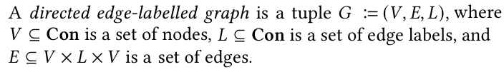
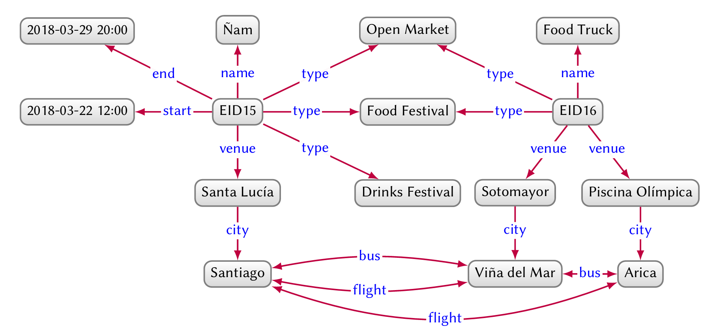
Knowledge Graph: Data Models
Directed edge-labelled graphs. A directed edge-labelled graph (also known as multi-relational graph o del graph) is defined as a set of nodes and a set of directed labelled edges between those nodes.
In the case of knowledge graphs, nodes are used to represent entities and edges are used to represent (binary) relations between those entities.
see Python NetworkX.DiGraph

Slide 10
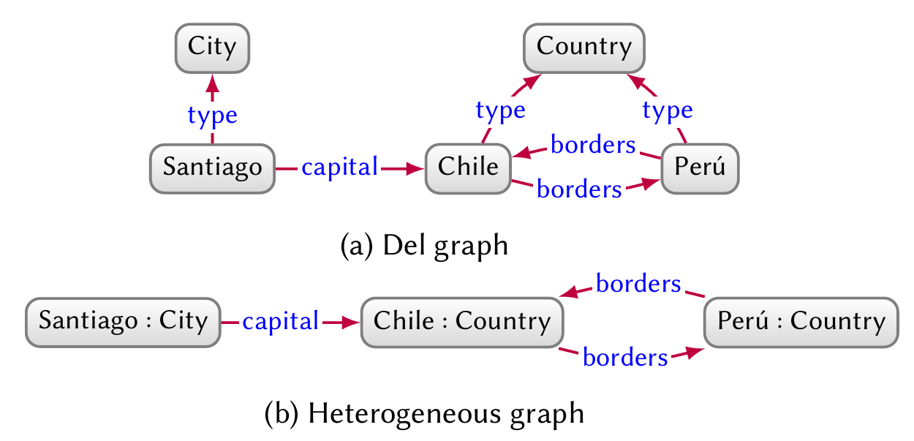
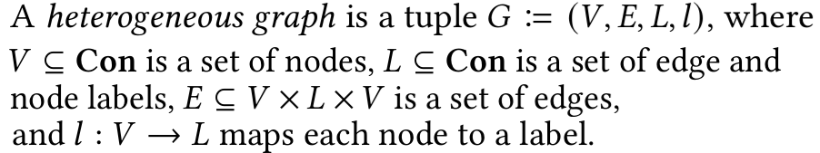
Knowledge Graph: Data Models
A heterogeneous graph (or heterogeneous information network ) is a graph where each node and edge is assigned one type. Heterogeneous graphs are thus akin to del graphs– with edge labels corresponding to edge types– but where the type of node forms part of the graph model itself, rather than being expressed as a special relation. An edge is called homogeneous if it is between two nodes of the same type (e.g., borders); otherwise, it is called heterogeneous (e.g., capital).
see Heterogeneous Graph Neural Networks (HGNN), NetworkX.DiGraph, PyTorch Geometric

Slide 11
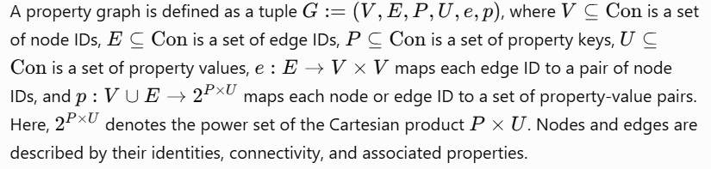
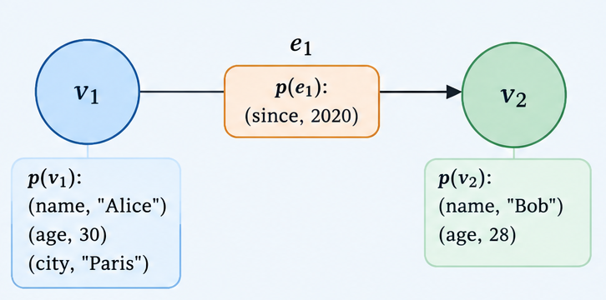
Knowledge Graph: Data Models

Slide 12
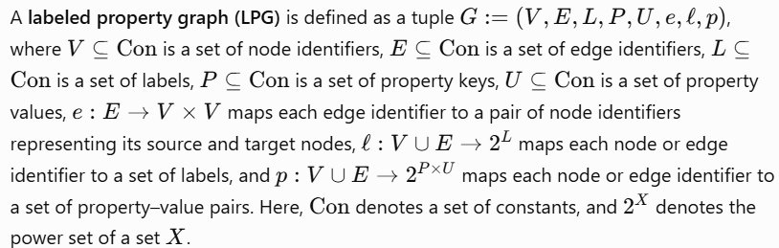
Knowledge Graph: Data Models

Slide 13
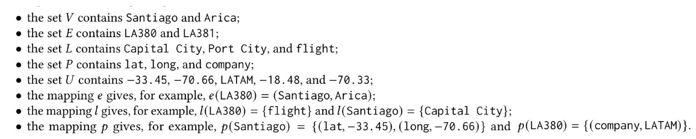
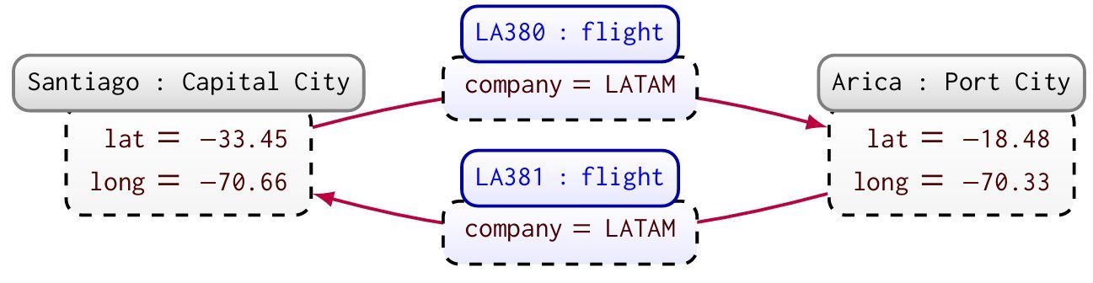

Slide 14
Knowledge Graph: Data Models
Labeled Property Graph is a property graph constituted by:
  Nodes represent entities or objects.
  Relationships (edges) connect nodes, are directed and have a type.
  Properties are key-value pairs attached to nodes or relationships.
  Labels can be used to classify nodes.
  There is no formal distinction between schema and data, everything is just nodes and edges:
    Flexible for integrating heterogenous sources
    Easy to grow in size (billions to trillions of data).
    Edges and nodes may come from a controlled vocabulary and have a special meaning.
    Nodes of the same label can have different properties.
    Nodes may have multiple labels

Slide 15

Let’s practise!
https://github.com/dfsantamaria/Knowledge-Representation-Reasoning/tree/main/on_lpg/movie_excerpt
Try on: https://arrows.app

Slide 16
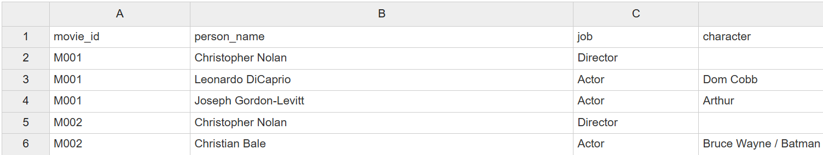
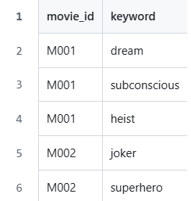

Slide 17
Should genres and production companies be properties or nodes? b. Should cast/crew credits be represented as edges with properties or as nodes? c. How to prevent duplicate entities?
1. Which films were released in a year?
2. Which person directed a film ?
3. Which films feature an actor?
4. Which character does a person play in a film?
5. Which films share a genre?
6. Which actors have appeared in films directed by a director?
7. Which production companies are associated with films in a given genre?
8. ...

